Slide 1
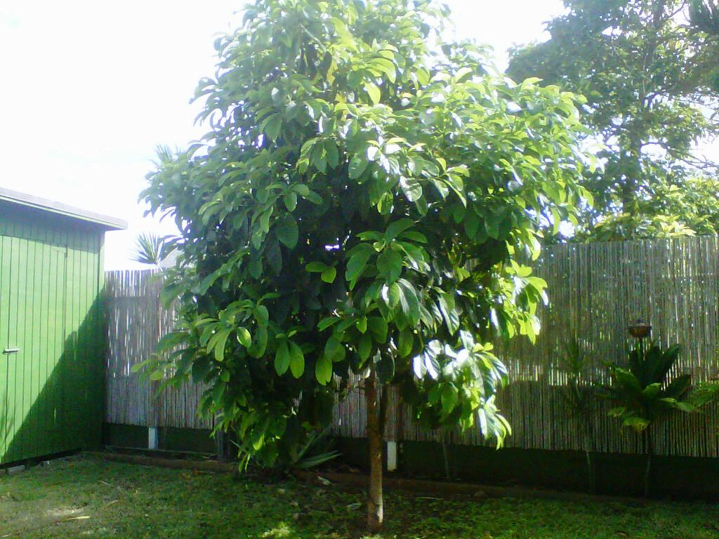
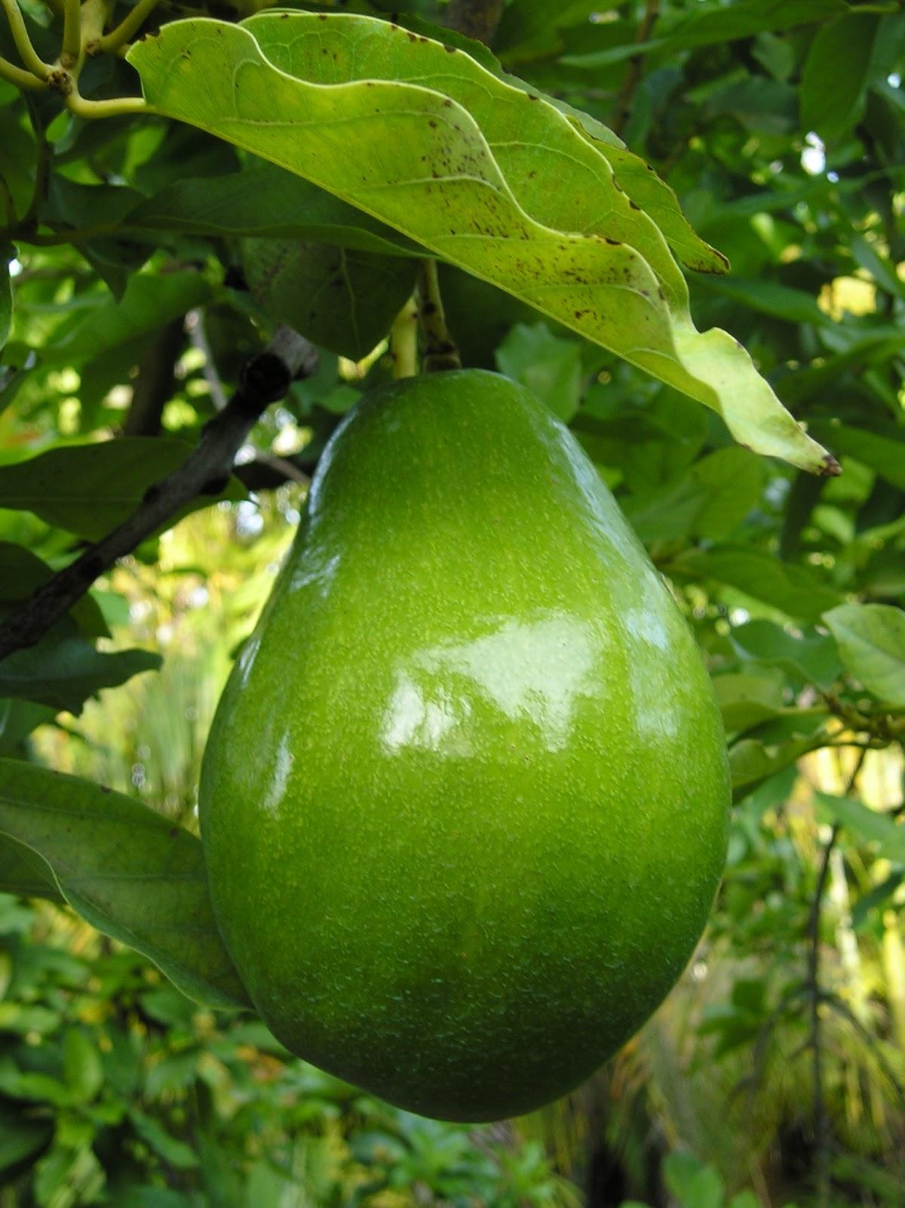
Symbolism:
Analyzing Layers of Meaning

Slide 2
Symbol: something that represents or stands for something else
LT: I can identify symbolism and use textual evidence to support my findings.

Slide 3
What symbols are common in our society?
When looking for meaningful textual evidence, keep an eye out for symbolism.
Some symbols are associated with many meanings. What different things could the ocean represent?
Some symbols are associated with one clear meaning. What does a ring symbolize?

Slide 4
Task:
LT- I can identify symbolism in a text and use textual evidence to support my findings.
In small groups (NO MORE THAN FOUR), read “The Grandfather,” by Gary Soto (pg 431). Analyze the text for symbols by collecting textual evidence that answers the following questions:
What details suggest that the author intends the avocado tree to have symbolic meaning?
What do the tree and Soto have in common?
Why is the avocado tree the Grandfather’s favorite tree? Why is this odd?
To what does the narrator compare the growth of the family? What part of the tree might the sons represent? What part of the tree represents the grandfather?
*You MUST have textual evidence for EACH question!*

Slide 5
Task:
LT- I can identify symbolism in a text and use textual evidence to support my findings.
In small groups (NO MORE THAN FOUR), read “The Grandfather,” by Gary Soto (pg 431). Analyze the text for symbols by collecting textual evidence that answers the following questions:
What details suggest that the author intends the avocado tree to have symbolic meaning?
What do the tree and Soto have in common?
Why is the avocado tree the Grandfather’s favorite tree? Why is this odd?
To what does the narrator compare the growth of the family? What part of the tree might the sons represent? What part of the tree represents the grandfather?
*You MUST have textual evidence for EACH question!*

Slide 6
Task:
LT- I can identify symbolism in a text and use textual evidence to support my findings.
In small groups (NO MORE THAN FOUR), read “The Grandfather,” by Gary Soto (pg 431). Analyze the text for symbols by collecting textual evidence that answers the following questions:
What details suggest that the author intends the avocado tree to have symbolic meaning?
What do the tree and Soto have in common?
Why is the avocado tree the Grandfather’s favorite tree? Why is this odd?
To what does the narrator compare the growth of the family? What part of the tree might the sons represent? What part of the tree represents the grandfather?
*You MUST have textual evidence for EACH question!*

Slide 7
Task:
LT- I can identify symbolism in a text and use textual evidence to support my findings.
In small groups (NO MORE THAN FOUR), read “The Grandfather,” by Gary Soto (pg 431). Analyze the text for symbols by collecting textual evidence that answers the following questions:
What details suggest that the author intends the avocado tree to have symbolic meaning?
What do the tree and Soto have in common?
Why is the avocado tree the Grandfather’s favorite tree? Why is this odd?
To what does the narrator compare the growth of the family? What part of the tree might the sons represent? What part of the tree represents the grandfather?
*You MUST have textual evidence for EACH question!*

Slide 8
Task:
LT- I can identify symbolism in a text and use textual evidence to support my findings.
In small groups (NO MORE THAN FOUR), read “The Grandfather,” by Gary Soto (pg 431). Analyze the text for symbols by collecting textual evidence that answers the following questions:
What details suggest that the author intends the avocado tree to have symbolic meaning?
What do the tree and Soto have in common?
Why is the avocado tree the Grandfather’s favorite tree? Why is this odd?
To what does the narrator compare the growth of the family? What part of the tree might the sons represent? What part of the tree represents the grandfather?
*You MUST have textual evidence for EACH question!*

Slide 9
Task:
LT- I can identify symbolism in a text and use textual evidence to support my findings.
In small groups (NO MORE THAN FOUR), read “The Grandfather,” by Gary Soto (pg 431). Analyze the text for symbols by collecting textual evidence that answers the following questions:
What details suggest that the author intends the avocado tree to have symbolic meaning?
What do the tree and Soto have in common?
Why is the avocado tree the Grandfather’s favorite tree? Why is this odd?
To what does the narrator compare the growth of the family? What part of the tree might the sons represent? What part of the tree represents the grandfather?
*You MUST have textual evidence for EACH question!*

